Slide 1
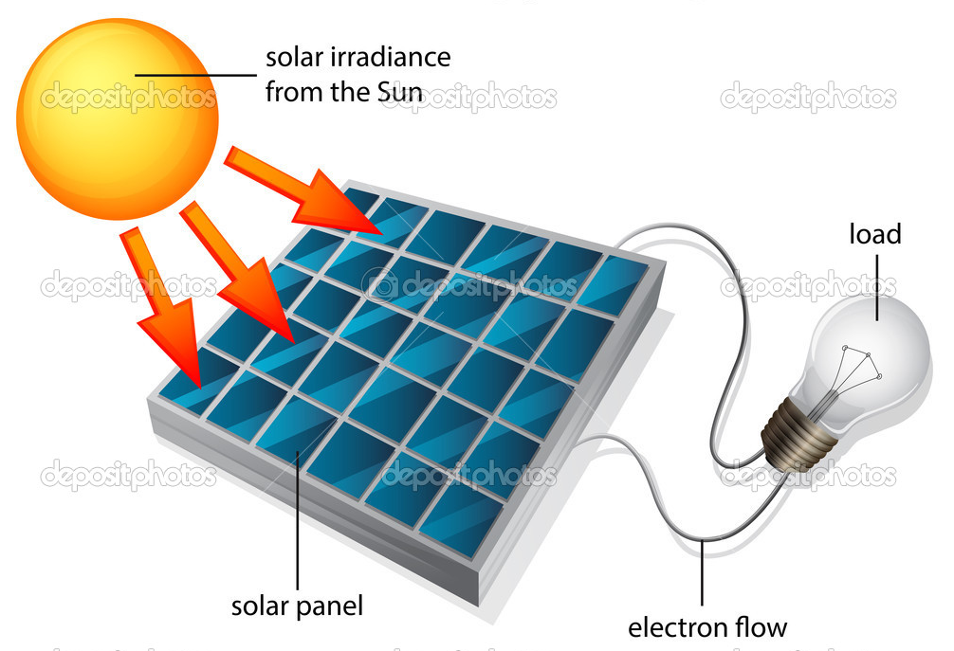
Energy from the Sun

Slide 2
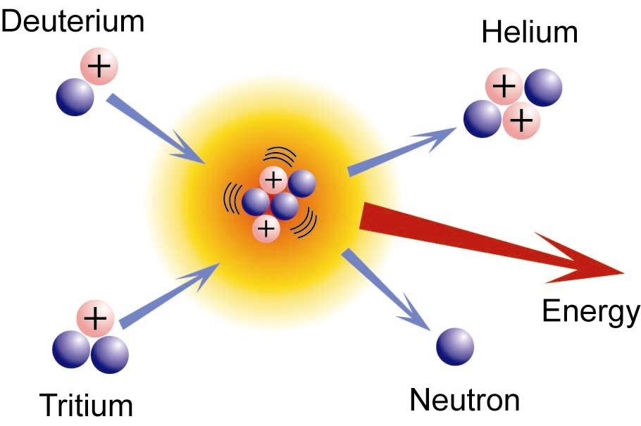
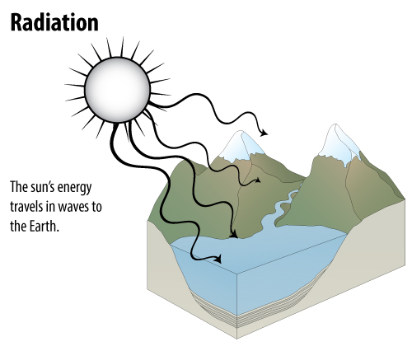
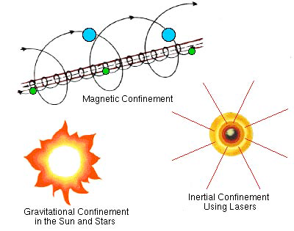
Solar Energy
Nuclear Fusion
Solar radiation Energy:
ITER: 500 MW ..International Thermonuclear Experimental Reactor in France by 2020
HiPER:
High Power laser Energy Research facility in France
Notes:
Under extreme pressure, and at extremely high temperatures, nuclei of atoms and their electrons can separate, forming plasma. In this extremely high energy state, nuclei can get close enough to each other to fuse. When they fuse, they release tremendous amounts of energy. This is what happens in the sun’s core.
The energy produced by fusion can be reabsorbed by other nuclei and re-released in future fusion reactions. Energy released in the core of the sun can take thousands of years to find its way to the surface of the sun.
Once the energy has left the sun, it is radiated as electromagnetic radiation toward space at a speed of 300 million meters per second, or 186,000 miles per second. At that speed, the energy needs only 8 minutes to reach the outer atmosphere of the earth 93 million miles away.
Once it reaches the earth, the incoming solar radiation, or insolation, is absorbed and reflected. The greenhouse effect, a naturally-occurring phenomenon, allows the energy from the sun to remain trapped near the earth’s surface, keeping the temperature of the earth in a comfortable range at night. Without the greenhouse effect, life on earth would be impossible.

Slide 3

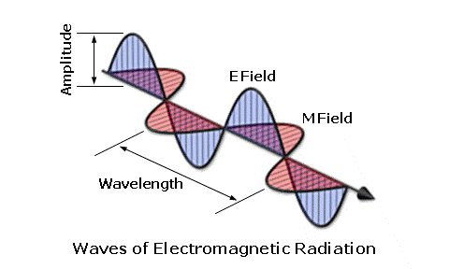
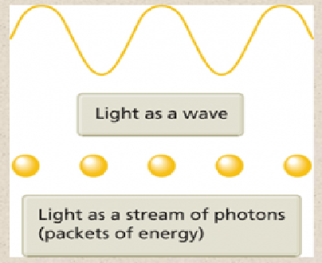
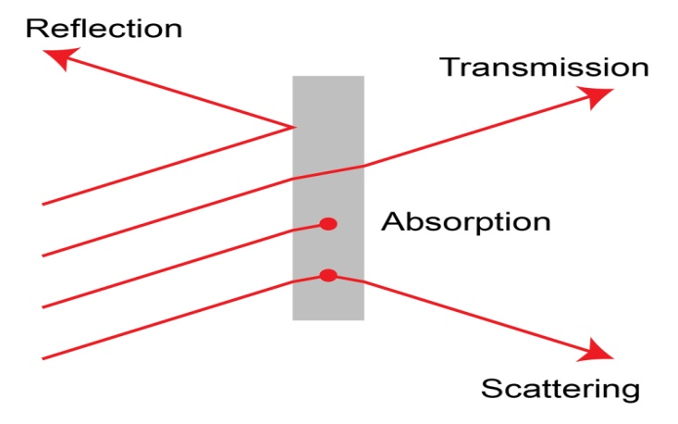
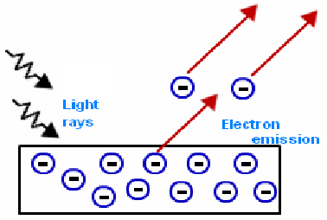
Solar radiation Energy:
Energy per unit volume (nhυ)
How to capture solar radiation energy???
Wave
or
Particle???

Slide 4

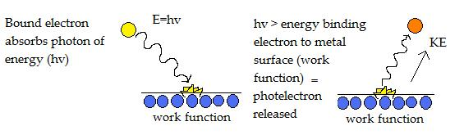
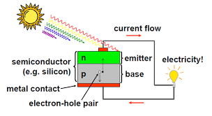
Solar radiation Energy:
Photo electric effect:
K.E = hυ- φ
In the photoemission process, if an electron within some material absorbs the energy of one photon and acquires more energy than the work function (the electron binding energy) of the material, it is ejected.

Slide 5
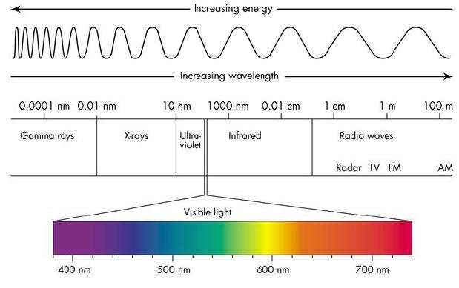
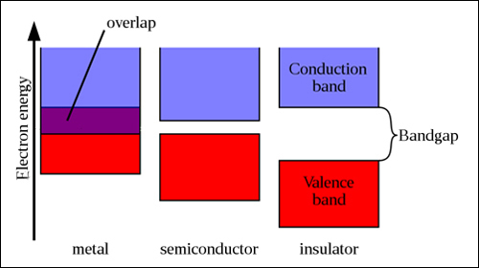
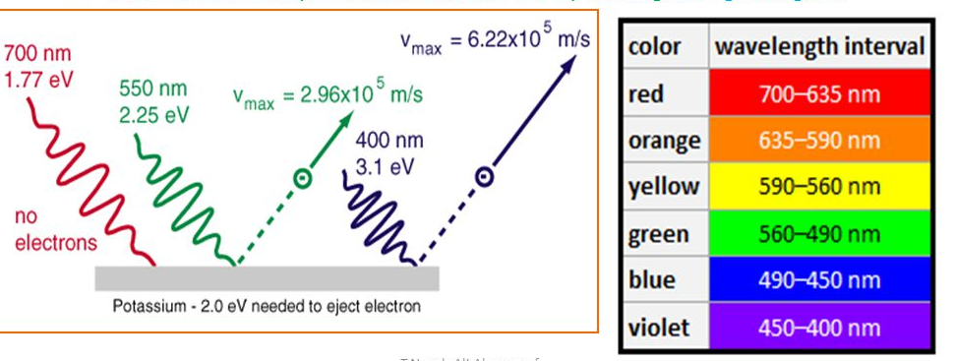
Solar radiation Energy:
Photo electric effect:
K.E = hυ- φ
Which frequency???
large frequency
or more no of photon/intensity???

Slide 6
Solar radiation Energy:
Photo electric effect:
K.E = hυ- φ
Only photons with an energy higher than the bandgap energy, can knock off electrons and generate electricity. However, if a photon has 1.7 eV and falls onto a 1.1 eV cell, the excess energy (0.6 eV) will be lost in the form of heat.
if you set the bandgap too high, you don't generate a lot of electrons (current) because few photons have so much energy. However, a bandgap too low will generate a lot of electrons, but most of the energy is lost in the form of heat

Slide 7
Photo electric effect
Material
Metal/Insulator/Semiconductor???
Band gap???
Frequency range
Absorption ???
Photon energy???
Free Electron ….. Current
Efficiency

Slide 8
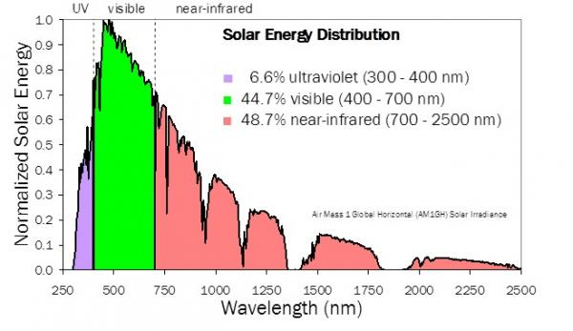
Frequency range
http://solarcellcentral.com/limits_page.html
Wavelength range = 400-1200 nm Frequency range = 7.5 x 10¹⁴ - 2.5 x 10¹⁴ Hz or 750 - 250 THz
Photon energy E=hc/λ
E (ev) = 1240/λ(nm)
=3 -1 ev
Solar energy spectra… broken/discontinuous???

Slide 9
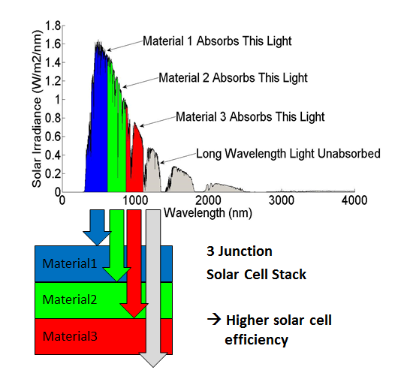
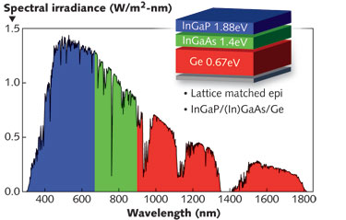
Frequency range/ Material/Band Gap
400-1200 nm
3 -1 ev
Why not conducting metal???

Slide 10
In insulator : the energy band gap between the valence band and conduction band is very large. the photons from the sunlight do not possess this amount of energy to excite the electrons from valence band to conduction band. In conductors, these band almost overlap each other and hence there are always free electrons. But free electrons does not mean flow of current. Free electrons moving in a specific direction is known as current. In conductors, the free electrons move randomly and hence the relative speed is 0 and also high KE so heating prob. In semiconductors, this gap is less and photons can do the task of exciting the electrons without any problem. In semiconductors, due to the presence of PN junction, there is a small electric field present within the semiconductors without which the solar cells won’t work. In the PN junctions, the electrons and holes try to mix with each other but they are not able to completely mix, Otherwise the junction will become neutral and will be of no use. When few electrons and holes combines with each other and rush towards the opposite charge, repulsive force comes into play due to the heavy rush of similar charges. A potential barrier is formed and when equilibrium is attained, we find the presence of small amount of electric field within it. This acts as a driving force for the free electrons, all in one direction.
Notes:
DC Voltage
Connect RED lead to VΩmA socket and BLACK to COM.
Set SWITCH to highest setting on DC VOLTAGE scale (1000).
Connect leads to the device to be tested using the alligator clips provided.
Adjust SWITCH to lower settings until a satisfactory reading is obtained.
With the photovoltaic modules and array, the 20 setting usually provides the best reading.
DC Current
Connect RED lead to VΩmA connector and BLACK to COM.
Set SWITCH to 10 ADC setting.
Connect leads to the device to be tested using the alligator clips provided.
Note: The reading indicates DC AMPS; a reading of 0.25 amps equals 250 ma (milliamps).

Slide 11
Materials for Solar cell
Solar cells are composed of various semiconducting materials
Crystalline silicon
Cadmium telluride
Copper indium diselenide
Gallium arsenide
Indium phosphide
Zinc sulphide
Note: Semiconductors are materials, which become electrically conductive when supplied with light or heat, but which operate as insulators at low temperatures
Notes:
A conducting wire connects the p-type silicon to an external load such as a light or battery, and then back to the n-type silicon, forming a complete circuit. As the free electrons are pushed into the n-type silicon they repel each other because they are of like charge. The wire provides a path for the electrons to move away from each other. This flow of electrons is an electric current that can power a load, such as a calculator or other device, as it travels through the circuit from the n-type to the p-type.
In addition to the semi-conducting materials, solar cells consist of a top metallic grid or other electrical contact to collect electrons from the semi-conductor and transfer them to the external load, and a back contact layer to complete the electrical circuit.
It is this flow of electrons that produces electrical current.

Slide 12
Over 95% of all the solar cells produced worldwide are composed of the semiconductor material Silicon (Si). As the second most abundant element in earth`s crust, silicon has the advantage, of being available in sufficient quantities.
To produce a solar cell, the semiconductor is contaminated or "doped".
"Doping" is the intentional introduction of chemical elements into the semiconductor.
By doing this, depending upon the type of dopant, one can obtain a surplus of either positive charge carriers (called p-conducting semiconductor layer) or negative charge carriers (called n-conducting semiconductor layer).

Slide 13
If two differently contaminated semiconductor layers are combined, then a so-called p-n-junction results on the boundary of the layers.
By doping trivalent element, we get p-type semiconductor. (with excess amount of hole)
By doping pentavalent element, we get n-type semiconductor ( with excess amount of electron)
p-n junction layer
n-type semiconductor
p- type semiconductor

Slide 14
6. Principle, construction and working of Solar cell
Principle: The solar cells are based on the principles of photovoltaic effect.The photovoltaic effect is the photogeneration of charge carriers in a light absorbing materials as a result of absorption of light radiation.
Construction
Solar cell (crystalline Silicon) consists of a n-type semiconductor (emitter) layer and p-type semiconductor layer (base). The two layers are sandwiched and hence there is formation of p-n junction.
The surface is coated with anti-refection coating to avoid the loss of incident light energy due to reflection.

Slide 15
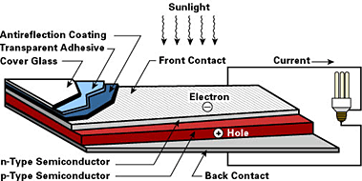

Slide 16
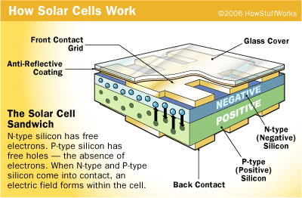

Slide 17
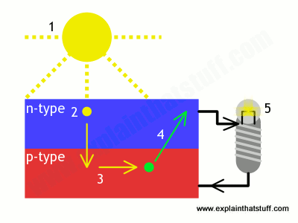
The mechanism of electricity production- Different stages
Conduction ban High density
Valence band Low density
E
The above diagram shows the formation of p-n junction in a solar cell. The valence band is a low-density band and conduction band is high-density band.

Slide 18
Stage-4
When the PN junction is connected with external circuit, the current flows.
Conduction band High density
Valence band Low density
junction
E
Power

Slide 19
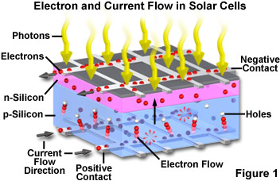

Photo Current Density:
Q(E) probability that incident photon of energy
E will deliver one electron to the external circuit
Q(E) depends on absorption coefficient of
solar cell material
E=hc/λ
E (ev) = 1240/λ(nm)
Notes:
A conducting wire connects the p-type silicon to an external load such as a light or battery, and then back to the n-type silicon, forming a complete circuit. As the free electrons are pushed into the n-type silicon they repel each other because they are of like charge. The wire provides a path for the electrons to move away from each other. This flow of electrons is an electric current that can power a load, such as a calculator or other device, as it travels through the circuit from the n-type to the p-type.
In addition to the semi-conducting materials, solar cells consist of a top metallic grid or other electrical contact to collect electrons from the semi-conductor and transfer them to the external load, and a back contact layer to complete the electrical circuit.
It is this flow of electrons that produces electrical current.

Slide 20
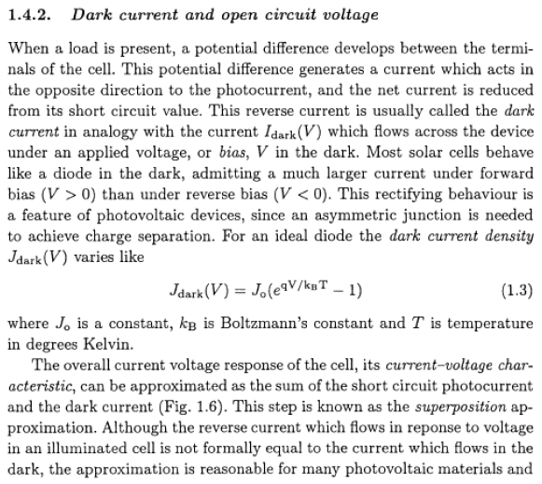
Notes:
A conducting wire connects the p-type silicon to an external load such as a light or battery, and then back to the n-type silicon, forming a complete circuit. As the free electrons are pushed into the n-type silicon they repel each other because they are of like charge. The wire provides a path for the electrons to move away from each other. This flow of electrons is an electric current that can power a load, such as a calculator or other device, as it travels through the circuit from the n-type to the p-type.
In addition to the semi-conducting materials, solar cells consist of a top metallic grid or other electrical contact to collect electrons from the semi-conductor and transfer them to the external load, and a back contact layer to complete the electrical circuit.
It is this flow of electrons that produces electrical current.

Slide 21
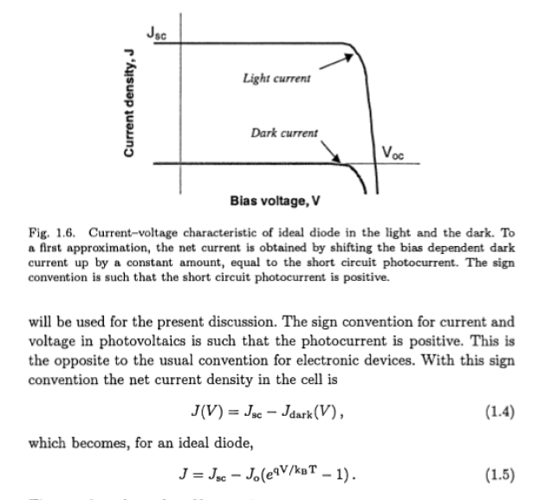
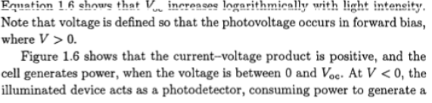
Notes:
A conducting wire connects the p-type silicon to an external load such as a light or battery, and then back to the n-type silicon, forming a complete circuit. As the free electrons are pushed into the n-type silicon they repel each other because they are of like charge. The wire provides a path for the electrons to move away from each other. This flow of electrons is an electric current that can power a load, such as a calculator or other device, as it travels through the circuit from the n-type to the p-type.
In addition to the semi-conducting materials, solar cells consist of a top metallic grid or other electrical contact to collect electrons from the semi-conductor and transfer them to the external load, and a back contact layer to complete the electrical circuit.
It is this flow of electrons that produces electrical current.

Slide 22
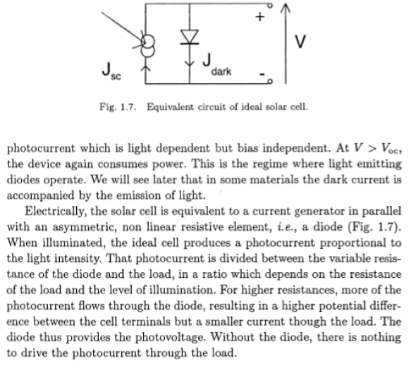
Notes:
A conducting wire connects the p-type silicon to an external load such as a light or battery, and then back to the n-type silicon, forming a complete circuit. As the free electrons are pushed into the n-type silicon they repel each other because they are of like charge. The wire provides a path for the electrons to move away from each other. This flow of electrons is an electric current that can power a load, such as a calculator or other device, as it travels through the circuit from the n-type to the p-type.
In addition to the semi-conducting materials, solar cells consist of a top metallic grid or other electrical contact to collect electrons from the semi-conductor and transfer them to the external load, and a back contact layer to complete the electrical circuit.
It is this flow of electrons that produces electrical current.

Slide 23
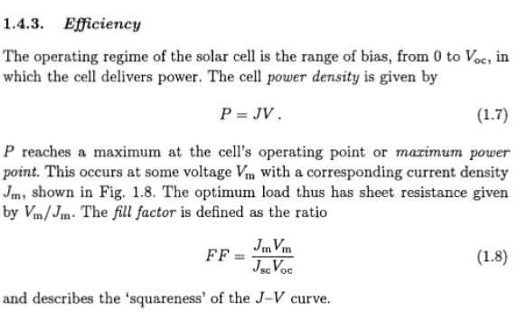
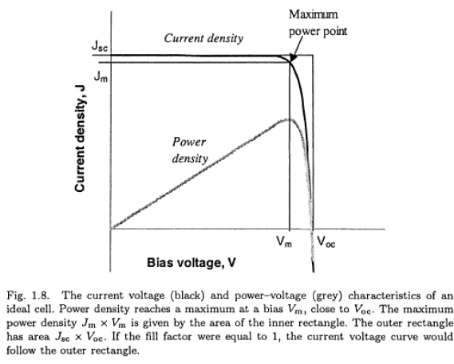
Or
Fill factor
FF = (V_{max}. I_{max})/(V_{oc}.I_{sc})
And efficiency of solar cell
η= V_{max}. I_{max}/P_{in}
Notes:
A conducting wire connects the p-type silicon to an external load such as a light or battery, and then back to the n-type silicon, forming a complete circuit. As the free electrons are pushed into the n-type silicon they repel each other because they are of like charge. The wire provides a path for the electrons to move away from each other. This flow of electrons is an electric current that can power a load, such as a calculator or other device, as it travels through the circuit from the n-type to the p-type.
In addition to the semi-conducting materials, solar cells consist of a top metallic grid or other electrical contact to collect electrons from the semi-conductor and transfer them to the external load, and a back contact layer to complete the electrical circuit.
It is this flow of electrons that produces electrical current.

Slide 24
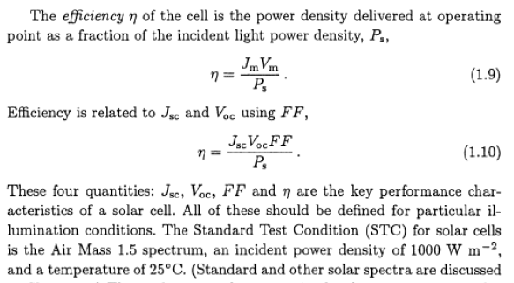
Or
Fill factor
FF = (V_{max}. I_{max})/(V_{oc}.I_{sc})
And efficiency of solar cell
η= V_{max}. I_{max}/P_{in}
Notes:
A conducting wire connects the p-type silicon to an external load such as a light or battery, and then back to the n-type silicon, forming a complete circuit. As the free electrons are pushed into the n-type silicon they repel each other because they are of like charge. The wire provides a path for the electrons to move away from each other. This flow of electrons is an electric current that can power a load, such as a calculator or other device, as it travels through the circuit from the n-type to the p-type.
In addition to the semi-conducting materials, solar cells consist of a top metallic grid or other electrical contact to collect electrons from the semi-conductor and transfer them to the external load, and a back contact layer to complete the electrical circuit.
It is this flow of electrons that produces electrical current.

Slide 25
Advantages of Solar Energy
Clean
Sustainable
Free
Provide electricity to remote places
Notes:
Solar energy produces no air pollution, thermal pollution, or water pollution, nor does acquiring solar energy disrupt a natural environment. The sun simply shines whether we use the energy or not. Solar energy is a completely sustainable energy source. Yes, one day the sun will stop producing energy, but if that happens we will have more problems to worry about than how we’ll charge our cell phones! Solar energy is one of the last free resources available to us, and it is available to us in such vast quantities we could never use all of it at any given time. Because the sun shines everywhere, and not just where people are, it can be used in places where electricity may not be otherwise available or practical.

